Slide 1

LACROSSE IN SCHOOLS
* PRESENTER NAME | * PRESENTATION DATE

Slide 2
WELCOME
NOTE:
Thank you for your interest in starting a conversation and opening the dialogue around incorporating lacrosse in your school.
Please use the following slides as a template. Customize this PowerPoint to inform and address your school board, administrators, donors, etc.
Asterisks (*) indicate areas where your school-specific details are needed.
To open hyperlinks, please view this resource as a Slide Show Presentation.
LACROSSE IN SCHOOLS
2

Slide 3
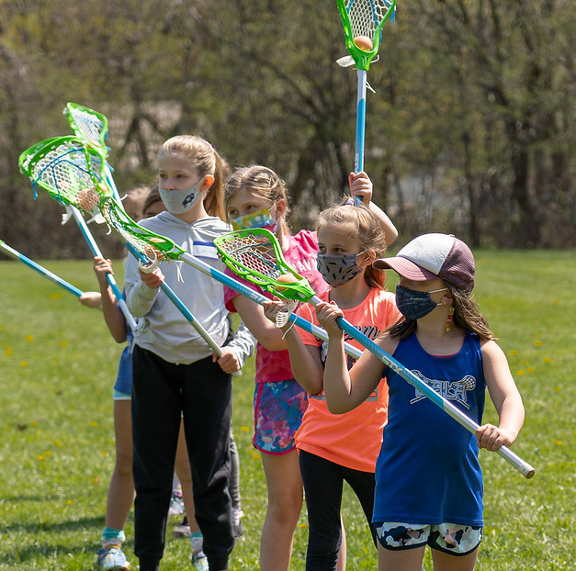
ABOUT USA LACROSSE
OUR MISSION
As the governing body of lacrosse in the United States, USA Lacrosse provides national leadership, structure, and resources to fuel the sport’s growth and enrich the experience of participants.
OUR VISION
We envision a future that offers everyone a lifelong opportunity to enjoy the sport of lacrosse.
LACROSSE IN SCHOOLS
3

Slide 4
HELPFUL LINKS
EDUCATION & TRAINING
Coach Resources: https://www.usalacrosse.com/coaches
Coach Certification: https://www.usalacrosse.com/coach-certification
Official’s Resources: https://www.usalacrosse.com/officials
Official’s Certification: https://www.usalacrosse.com/officials-certification
Men’s Game Rules: https://www.usalacrosse.com/boys-and-mens-rules
Women’s Game Rules: https://www.usalacrosse.com/girls-and-womens-rules
COACHES, OFFICIALS, AND PLAYERS
A safe and positive playing experience starts with knowing the rules and how to appropriately and effectively coach, officiate, and play the game.
Coach Resources: Whether you're an experienced coach or getting ready to lead a team for the first time, USA Lacrosse is ready to help you achieve success. The USAL coach certification program is an organized approach to make sure you have everything covered, making you the best coach you can be.
Official’s Resources: Whether you’re just starting out in stripes or looking to tackle a new challenge, USA Lacrosse is here to help you advance on your officiating journey. USAL works side-by-side the top officials in the country to develop certified training programs that will help you prepare you for everything you’ll see on the field.
LACROSSE IN SCHOOLS
4

Slide 5
HELPFUL LINKS
SAFETY
Center for Sport Science: https://www.usalacrosse.com/center-sport-science
Research: https://www.usalacrosse.com/research
Concussion Awareness: https://www.usalacrosse.com/concussion-awareness
Commotio Cordis and Cardiac Safety: https://www.usalacrosse.com/commotio-cordis-cardiac-safety
Abuse Prevention: https://www.usalacrosse.com/abuse-prevention
CENTER FOR SPORT SCIENCE
A national hub for the study and improvement of health, safety, and performance in lacrosse.
Created in 2016, the Center is devoted to research, education, collaboration, policy development, and best practices guidelines that benefit the safety and wellness of lacrosse players, with a particular focus on youth players.
The dedicated volunteers from our Sports Science & Safety Committee function as an advisory group for the Center and provide safety education leadership for the entire lacrosse community.
LACROSSE IN SCHOOLS
5

Slide 6
HELPFUL LINKS
EQUIPMENT
USA Lacrosse
Equipment Guide: https://www.usalacrosse.com/sites/default/files/documents/Safety/USAL-equipment-guide-low.pdf
Compliance and Standards: https://www.seinet.org/search.htm#sections=USLacrosse_collapse3
Chest Protector FAQ: https://www.usalacrosse.com/lacrosse-chest-protector-faq
Women’s Headgear FAQ: https://www.usalacrosse.com/womens-lacrosse-headgear-faq
Helmet Fitting Tips: https://www.usalacrosse.com/helmet-fitting-tips
STANDARDS AND REQUIREMENTS
For players just getting started in lacrosse, finding the right equipment can be confusing and intimidating. It’s important to know that there are key differences in the required protective equipment between the men’s and women’s game, as well as between field players and goalies. Box lacrosse has its own unique gender-neutral equipment requirements.
Minimal equipment is required in women’s lacrosse due to its non-contact nature. A stick, mouthguard, and protective eyewear are the only required items for most players. Goalies are required to wear a helmet with face mask, throat protector, padded gloves, and a chest protector.
Men’s field players are required to use a helmet, stick, gloves, shoulder pads, arm pads, a mouthguard, and a protective cup. Goalies are required to wear a helmet with face mask, throat protector, padded gloves, and a chest protector.
LACROSSE IN SCHOOLS
6

Slide 7
HELPFUL LINKS
RULES
Men’s Game Rules: https://www.usalacrosse.com/boys-and-mens-rules
Women’s Game Rules: https://www.usalacrosse.com/girls-and-womens-rules
Box Lacrosse Rules:
https://www.usalacrosse.com/box-rules
KEEPING THE GAME FAIR AND SAFE
The rules of lacrosse govern games and equipment. USA Lacrosse works collaboratively with the National Federation of State High School Associations (NFHS) and the NCAA to write the rules for our sport. The organizations often work together on rule development and player safety efforts.
USA Lacrosse writes and publishes youth rules for ages 14U and below, which align with the principles of the Lacrosse Athlete Development and feature age-appropriate guidelines. USA Lacrosse collaborates with the NFHS on the rules for high school boys' and girls' lacrosse. The NCAA writes the rules for varsity collegiate play, with modifications by USA Lacrosse for use by collegiate non-varsity (or club) and post-collegiate in women’s lacrosse.
USA Lacrosse also publishes rules to govern box lacrosse.
LACROSSE IN SCHOOLS
7

Slide 8
* YOUR SCHOOL OR TEAM NAME HERE
OUR MISSION & VISION
* Your school or program mission and vision here.
LACROSSE IN SCHOOLS
8

Slide 9
FUNDING
OVERVIEW
* Use this space to briefly explain how you will fund and support the cost of facilitating a lacrosse team and program. Reference the USA Lacrosse New Start Manual for recommendations and suggestions.
LACROSSE IN SCHOOLS
9

Slide 10
USA LACROSSE
COMMUNITY & SUPPORT
Use this space to briefly explain how you will utilize USA Lacrosse resources. See the Physical Education information page on usalacrosse.com for more information, including the free curriculum for lacrosse in the classroom. Reference the USA Lacrosse New Start Manual for recommendations and suggestions.
LACROSSE IN SCHOOLS
10

Slide 11
USA LACROSSE
COMMUNITY & SUPPORT
Use this space to briefly explain other organizations you can utilize that may support your program. Some example organizations are listed below.
Leveling the Playing Field gives underprivileged children the opportunity to enjoy the physical and emotional benefits of youth sports participation by giving completely free used and excess sporting equipment to community groups, youth leagues and schools serving low-income communities.
Donate to Sports Charity | Leveling the Playing Field
ReLax Collections Redistributes New and Used Lacrosse Equipment to Promote Education
Donate Lacrosse Equipment | International Distribution | ReLax Collections
Good Sports drives equitable access in youth sports by working with organizations in high-need communities serving youth ages 3-18.
Apply | Good Sports
The Women’s Sports Foundation continues their work to support individuals and communities of women to reach their limitless potential by providing resources that enable athletes to compete without barriers.
The Power of She Fund - Women's Sports Foundation (womenssportsfoundation.org)
LACROSSE IN SCHOOLS
11

Slide 12
TIMELINE
HIGH-LEVEL OUTLINE
* Use this space to communicate your plan for forming a team and facilitating programming. Include a timeline of events: registration due dates, coach recruitment, fundraising events, suggested practice/game schedules, etc.
LACROSSE IN SCHOOLS
12

Slide 13
SCHOOL SUPPORT
NEXT STEPS
* Use this space to briefly explain what is needed from your school and/or community. Keep your needs concise and easy to digest. Use bullet points for Next Steps and action items.
LACROSSE IN SCHOOLS
13

Slide 14
QUESTIONS?
CONTACT INFORMATION
* School/Program Website
* Presenter’s Name
* Presenter’s Title
* Presenter’s Email
USA Lacrosse Resources: www.usalacrosse.com
LACROSSE IN SCHOOLS
14

Slide 15


